Slide 1




Introduction to Competitive Programming
By Khaled Adrani

Slide 2

Content
Abstract
Definition
Importance
Prerequisites
Overview
Resources
What’s next?

Slide 3


Abstract

Slide 4
What is it?

Slide 5



What is Competitive Programming?
Notes:
A mind sport where participants compete by solving problems through programming.

Slide 6
Why?

Slide 7
Why is it important?
The will to win, the desire to succeed, the urge to reach your full potential… these are the keys that will unlock the door to personal excellence.
Confucius
Notes:
A mind sport where participants compete by solving problems through programming.

Slide 8



Why is it important?
Notes:
Many programmers argue that the problems in competitive programming do not relate to the real life programming work. For the most part, it is true. Then why do we do it? Because it makes you a better programmer. How?
Time limit always makes you write time efficient solutions.
Critical test data helps you write correct solutions, in one go!
Further it makes you great at debugging code.
Hard problems makes you break down the problem into chunks, solve them individually and bring it all together to solve the main problem.

Slide 9
With what?

Slide 10
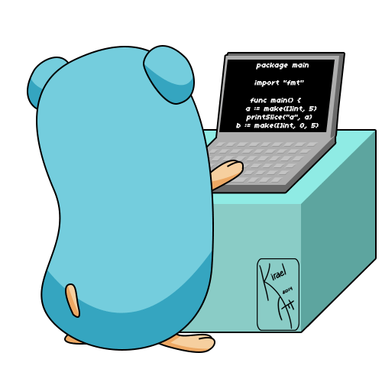
Prerequisites
Notes:
Programming Language
Research spirit
Able to read other people code
English

Slide 11

Prerequisites
Notes:
Programming Language
Research spirit
Able to read other people code
English

Slide 12
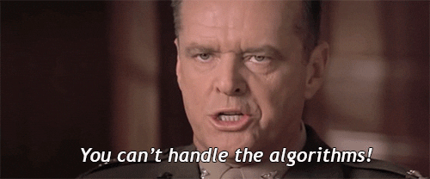
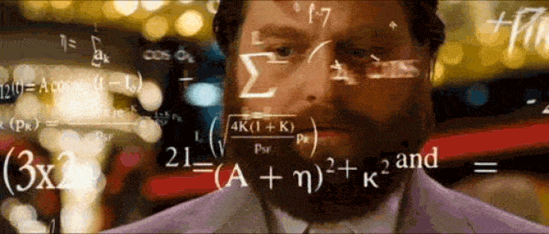
Prerequisites
Notes:
Programming Language
Research spirit
Able to read other people code
English

Slide 13
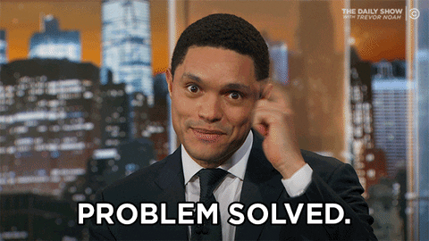
Prerequisites
Notes:
Programming Language
Research spirit
Able to read other people code
English

Slide 14
Prerequisites
Programming Language
Know how to search well
Not afraid to read other people code
English
Typical algorithms: sorting, search
Data structures
Algorithmic paradigms
Theory and Mathematics
Loving problem solving
Notes:
Level0:
Intermediate hold on any one programming language
English! Convert english to code!
Level1
Sort and Search algorithms
Hashing
Number Theory
Greedy Technique
Level2
Graph Theory
Disjoint Set Union (Union-find)
Minimum Spanning Tree programming.
level3
Segment Tree
String Algorithms
Tries, Suffix Tree, Suffix Array.
Level4
Heavy Light Decomposition
Graph Coloring, Network Flow
Sqrt Decomposition.

Slide 15
How?

Slide 16
Overview
Duration: 2-5 hours
Participation: Individual or team
Number of problems: it depends
Problems types: Algorithms, Data Science
Problems styles: Statement, Input/Output format, Constraints, examples
Solutions: few to dozens of line
Testing solutions: Automated testing system
Require knowledge

Slide 17
From?

Slide 18





Resources

Slide 19







Resources

Slide 20
So?

Slide 21
Steps to solve a problem
Read and understand the statement
Formalize it
Design a solution
Implement it
Test it
Debug IF errors
Submit to the testing system
Repeat in case the solution is not right

Slide 22



What’s next?
Participate in competitions and coding websites!
Keep Learning and getting feedback!
Remember always the why

Slide 23
Resources for this presentation
https://content.techgig.com/5-reasons-to-study-competitive-programming/articleshow/76064853.cms
https://www.hackerearth.com/getstarted-competitive-programming/
https://www.coursera.org/learn/competitive-programming-core-skills/home/welcome
https://www.coursera.org/learn/algorithmic-toolbox/home/welcome

Slide 24
Contact me : khaledadrani@gmail.com

Slide 25
Thank you very much !
Any questions?

